Slide 1
IBM University Engagement Project Submission
“Exploring the Power of Agentic AI with IBM Granite and LangFlow”

Slide 2
Project Tile – [Intelligent Shopping Agent]
Domain of Project – E-commerce]
Student Name | Recent Passport Photo | Email ID | Mobile number [WhatsApp]
Prasad Shivaji Gaware |  | gawareprasad00@gmail.com
Recommended font style and size: Font Style: Arial Font Size (Heading): 28
Font Size (Content): 20

Slide 3
Problem Statement -
Problem Statement : Intelligent Shopping Agent
The Challenge :
Online shoppers often struggle to make informed purchasing decisions due to the overwhelming number of products, inconsistent pricing across platforms, fake or biased reviews, complex technical specifications, and the time required to compare multiple options. This leads to confusion, poor buying decisions, and missed opportunities for better value.
The Objective :
To develop an AI-powered shopping assistant that simplifies the online shopping experience.
To understand user requirements, including budget, preferences, and intended product usage.
To compare products across multiple e-commerce platforms based on price, features, specifications, ratings, and reviews.
To provide personalized and unbiased product recommendations using AI-driven analysis.
To analyze customer reviews and summarize key advantages and disadvantages of each product.
To identify the best value-for-money products and suggest suitable alternatives when needed.
To track price trends and notify users of the best time to purchase.
To reduce the time and effort required for product research and comparison.
To improve customer confidence by providing transparent explanations for every recommendation.
To enable users to make faster, smarter, and more informed purchasing decisions.

Slide 4
Proposed Solution -
Proposed Solution: AI-Powered Intelligent Shopping
1. AI-Based Shopping Assistant
Develop an intelligent AI agent that acts as a personal shopping assistant, understanding user requirements and providing tailored product recommendations.
2. Personalized User Understanding
The system collects user preferences such as budget, preferred brands, product purpose, and desired features to deliver personalized shopping experiences.
3. Multi-Platform Product Search
The agent searches products across multiple trusted e-commerce platforms, ensuring users have access to a wide range of options and competitive prices.
4. Intelligent Product Comparison
Products are compared based on price, specifications, features, ratings, customer reviews, warranty, and overall value for money, enabling informed decision-making.
5. AI-Powered Review Analysis
Using Natural Language Processing (NLP), the system analyzes thousands of customer reviews to summarize common advantages, disadvantages, and overall customer sentiment.
6. Smart Recommendation Engine
The AI ranks products according to user preferences and provides unbiased recommendations with clear explanations for why a product is the best choice.
7. Price Tracking and Deal Detection
The system monitors price changes, identifies discounts and offers, and helps users determine the best time to purchase a product.
8. Alternative Product Suggestions
If a product is unavailable, overpriced, or not the best fit, the agent recommends similar or better alternatives based on performance and value.

Slide 5
Technology Used
Langflow platform -For designing and orchestrating multi-agent workflows visually
IBM Granite model - for eg – ibm-granite-3-2-8b – For natural language understanding, reasoning, and personalization
IBM Cloud – It provides the infrastructure to build, deploy, and scale the Shopping Agent efficiently. IBM Cloud enables a reliable, secure, and scalable environment for deploying the Shopping Agent.
RAG– RAG to fetch real data first, then generate intelligent answers, making the Shopping Agent more trustworthy and effective.
IBM Watsonx.ai - For model deployment, embeddings, and AI governance
Vector Database (FAISS/Chroma) – For RAG-based product data retrieval

Slide 6
Langflow component Used -
Langflow Components Used
1. Chat Input
Receives the user's shopping query, preferences, budget, and product requirements.
2. Prompt Template
Structures the user's input into a well-defined prompt, guiding the AI to perform product search, comparison, and recommendation tasks.
3. Large Language Model (LLM)
Processes user requests, understands intent, analyzes product information, compares options, and generates personalized recommendations with explanations.
\5. API / Tool Components
Connects to external APIs such as e-commerce platforms, price trackers, or product databases to retrieve real-time product information, pricing, specifications, and reviews.
6. Data Parser
Extracts and organizes product data into a structured format for accurate comparison and analysis.
8. Recommendation Engine
Ranks products based on multiple factors including price, features, ratings, reviews, and user preferences to identify the best options.
9. Output Parser
Formats the AI-generated response into a clear and user-friendly comparison table, summary, or recommendation.
10. Chat Output
Displays the final recommendations, product comparisons, review summaries, price insights, and purchasing suggestions to the user.

Slide 7
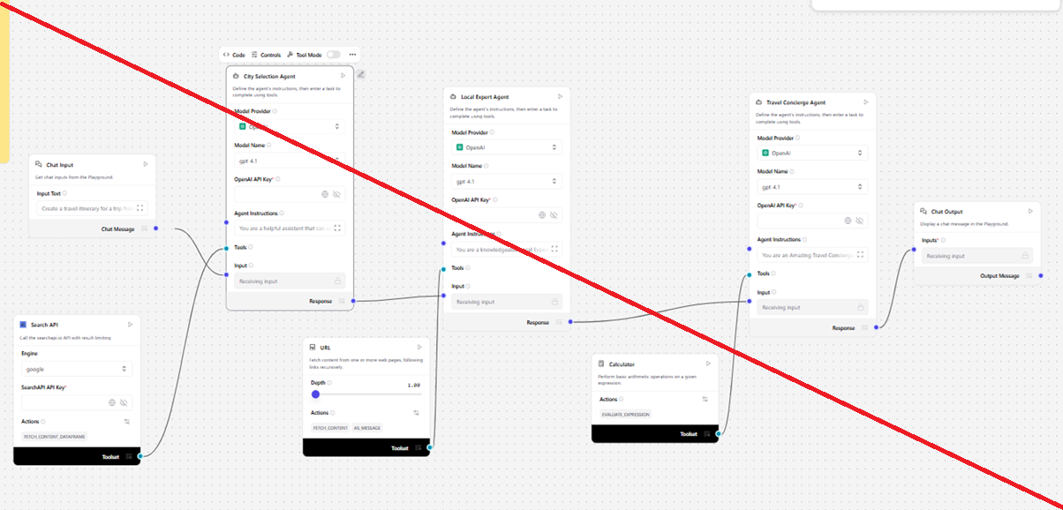
Langflow workflow -

Slide 8
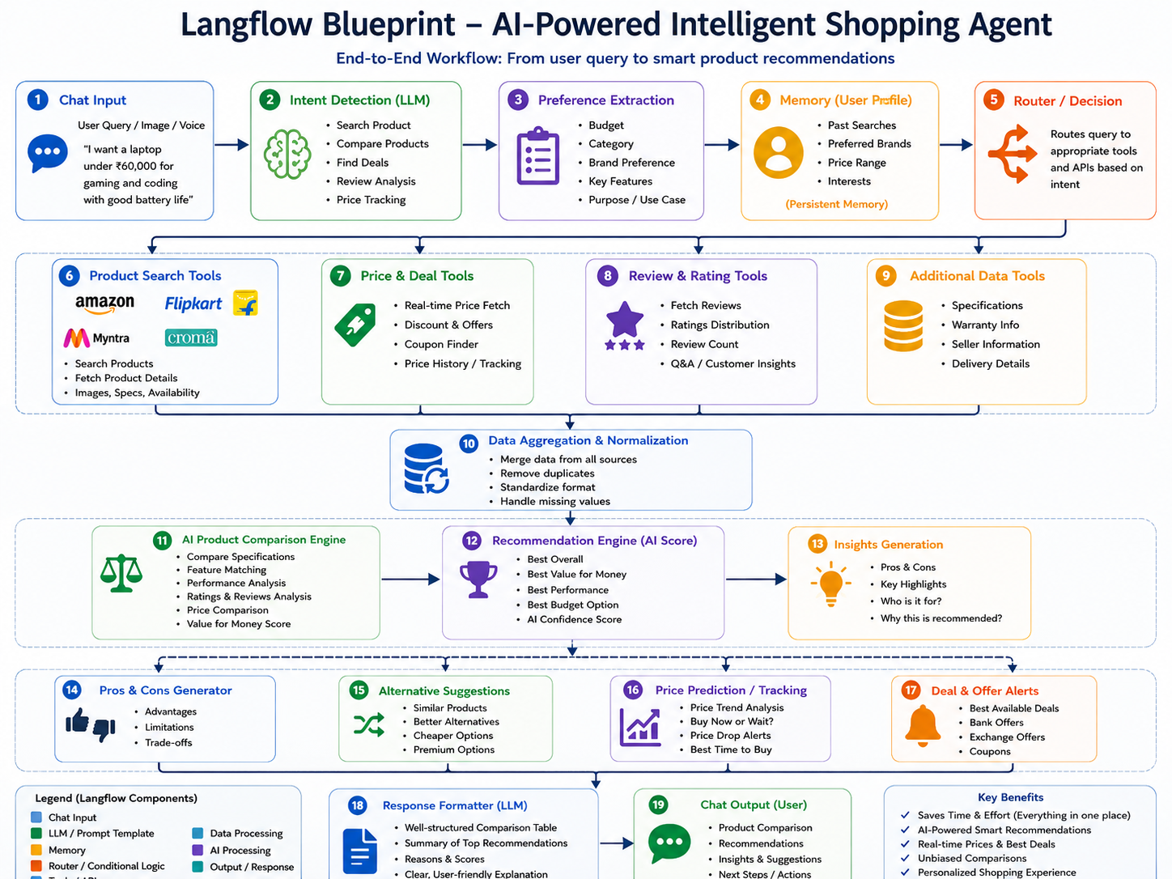
Architecture blueprint

Slide 9

Role of Agentic AI in the solution
Role of Agentic AI in Nutrition Agent
Agentic AI enables the Nutrition Agent to function as an intelligent, autonomous system rather than a simple chatbot. Using IBM watsonx.ai and IBM Granite models, it coordinates multiple specialized agents to deliver personalized nutrition guidance.
Agentic AI serves as the core intelligence of the shopping assistant by autonomously understanding user requirements, planning the shopping workflow, and executing tasks without constant user intervention. Unlike traditional chatbots, the Agentic AI can reason, make decisions, utilize multiple tools, and adapt its actions based on the user's preferences and real-time product data.
Key Roles of Agentic AI
Understands User Intent: Interprets natural language queries to identify the user's needs, budget, preferences, and shopping goals.
Autonomous Product Discovery: Searches across multiple e-commerce platforms to gather relevant product information.
Intelligent Decision-Making: Evaluates products based on price, specifications, ratings, reviews, and value for money.
Multi-Tool Orchestration: Coordinates APIs, search tools, price trackers, and review analyzers to collect and process data efficiently.
Personalized Recommendations: Generates customized product suggestions based on user preferences and previous interactions.

Slide 10


Token Usage
11,761 token are used
Before Prompt
After the Prompt
·
·
·

Slide 11
Novelty and Uniqueness
The proposed Nutrition Agent stands out by combining Agentic AI, RAG, and personalization into a single intelligent system.
Novelty and Uniqueness
The proposed AI-Powered Intelligent Shopping Agent goes beyond traditional shopping assistants by combining Agentic AI, multi-platform product comparison, and intelligent decision-making into a single solution. Instead of simply displaying products, the system autonomously understands user intent, plans the shopping process, gathers information from multiple sources, analyzes product reviews and pricing, and provides personalized recommendations with clear reasoning.
Key Novel Features
Agentic AI-Based Decision Making: Performs autonomous reasoning, planning, and task execution instead of responding with predefined answers.
Multi-Platform Product Intelligence: Compares products across multiple e-commerce platforms in one place.
Personalized Recommendations: Tailors suggestions based on user preferences, budget, and shopping history.
AI Review & Sentiment Analysis: Summarizes thousands of customer reviews to identify genuine pros, cons, and overall sentiment.
Real-Time Price Intelligence: Tracks price changes, detects deals, and recommends the best time to buy.
Explainable Recommendations: Clearly explains why a product is recommended and highlights trade-offs.

Slide 12
Git Hub Link
Please create public github repository (Enable Add README button while creating repository) with format –
Please test and Paste the working Github URL –
Make sure you have Uploaded following three files into your github repository 1) app.json file , 2) yourproblemstatement.pdf file 3) your projectpresntation.pptx file 4)any other files
·
·
·

Slide 13
Future Scope
Future Scope
The proposed AI-Powered Intelligent Shopping Agent can be further enhanced with advanced features to improve user experience and expand its capabilities.
Future Enhancements
Voice-Based Shopping Assistant: Enable users to search and compare products using voice commands.
Image-Based Product Search: Allow users to upload product images to find visually similar items across multiple platforms.
AR/VR Shopping Experience: Integrate Augmented Reality (AR) and Virtual Reality (VR) for virtual product visualization and try-on experiences.
Predictive Price Forecasting: Use AI models to accurately predict future price trends and recommend the optimal time to purchase.
Personalized Shopping Assistant: Continuously learn user preferences and provide highly customized recommendations.
·
·
·

Slide 14

Certificates Earned:
Please add your credly certificate

Slide 15
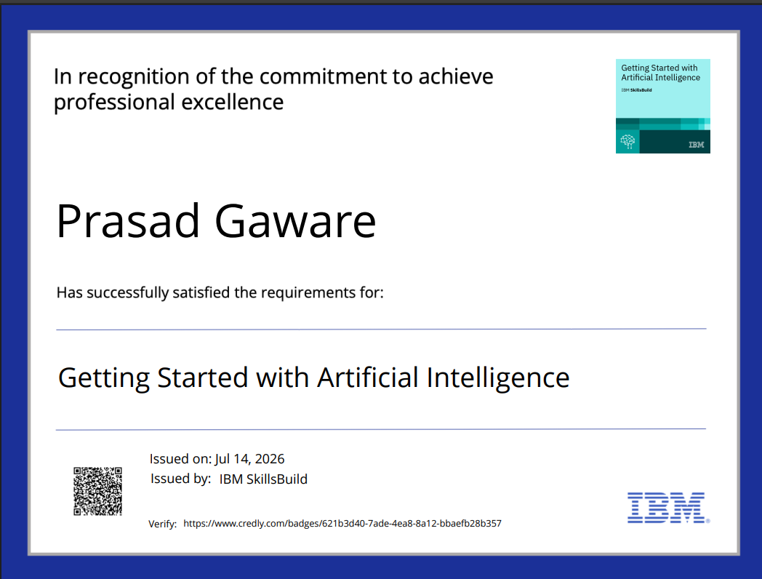

Slide 16
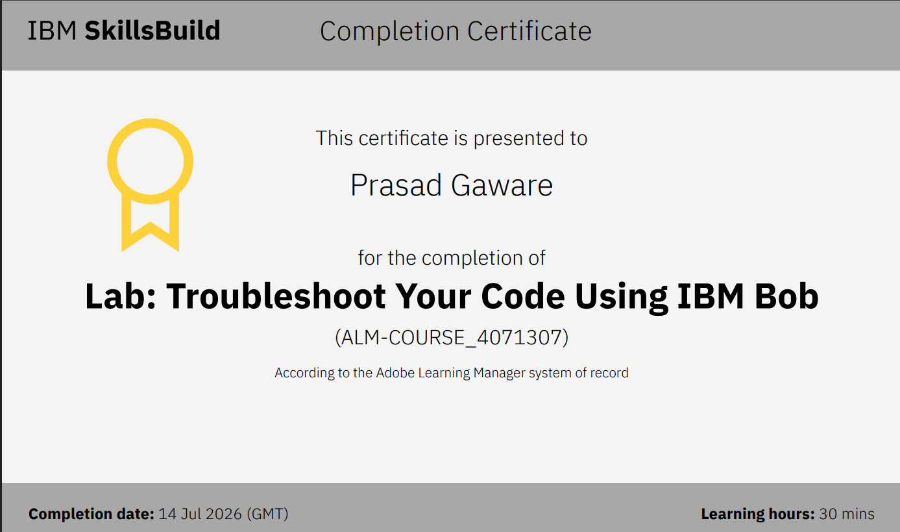
Certificates Earned:​
Add your IBM BOB Certificate

Slide 17


